Slide 1
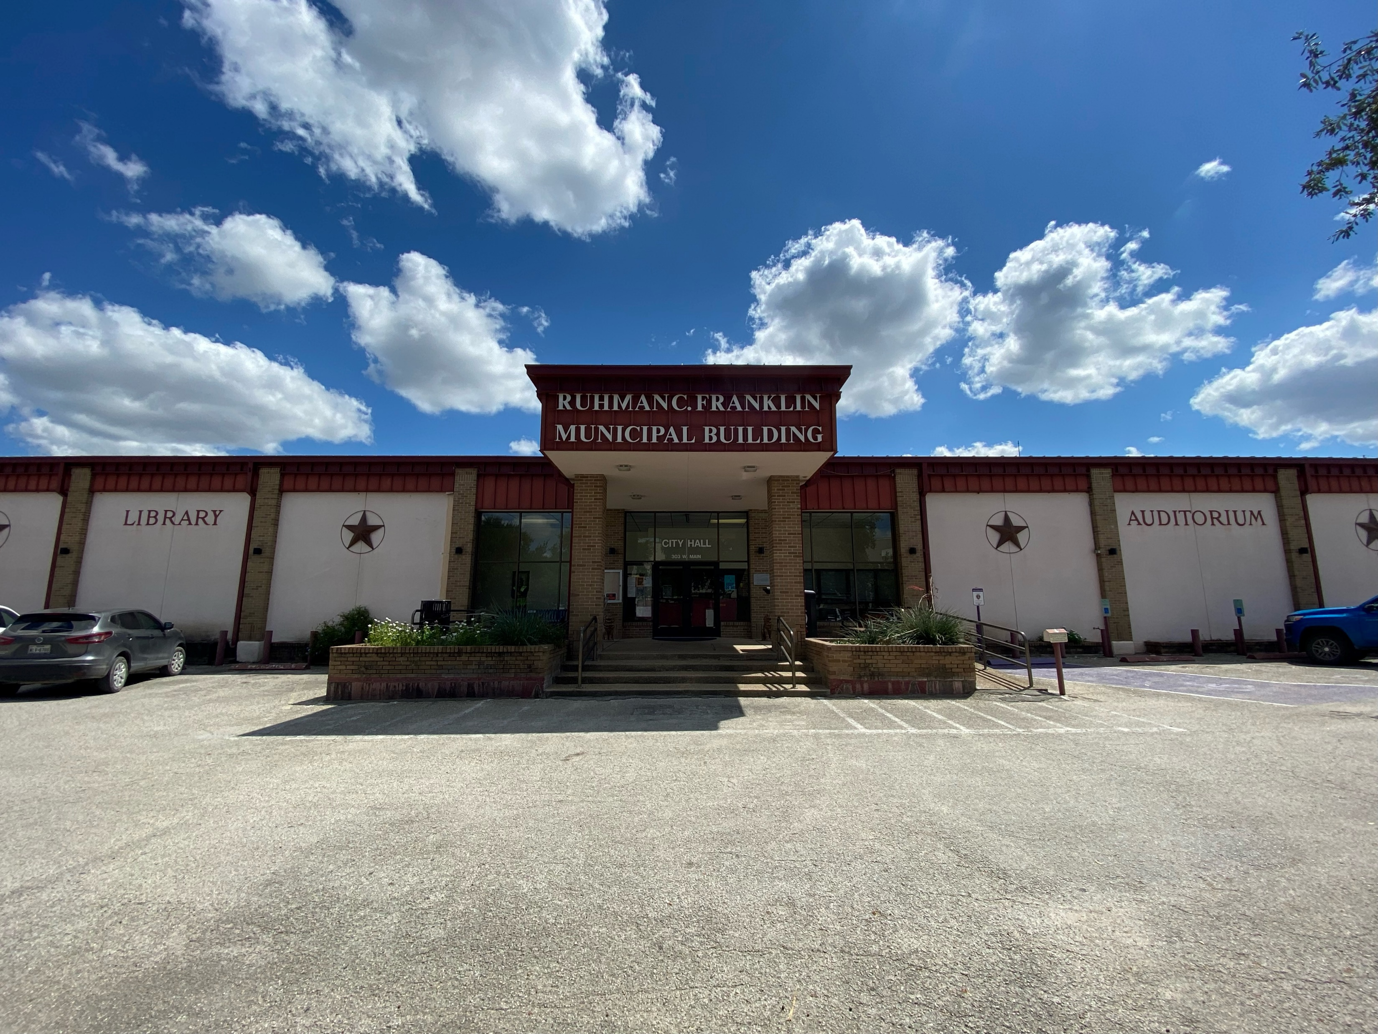
Customer Service Training for Municipal Workers
Presented by: Thomas Faulkner, MBA, MSML, SPHR, LSSBB

Slide 2

Training Objectives
Understand the unique challenges of providing customer service in the public sector.
Learn techniques to handle difficult customer interactions professionally.
Explore strategies to build trust and strengthen customer relationships.
Develop skills to provide consistent and exceptional service to residents.

Slide 3


Slide 4
Foundational Customer Service Skills

Slide 5
Section Overview
Objective: In this section, we will understand and build core skills that enhance our service quality and citizen satisfaction.
Key Skills We’ll Cover:
Customer Service Challenges
Communication Skills
Problem Solving Techniques
Professionalism and Public Expectations
Self-care in Customer Service

Slide 6

Key Challenges in Public Sector Customer Service
Citizens expect swift, efficient, and highquality service, often similar to private sector standards.
Discuss: How do citizen expectations differ from what tools and resources we have on hand to resolve the issue?
Budget constraints often limit staff, equipment, and response times.
Fact: 70% of municipal employees cite budgetary constraints as a major service challenge.
Service delivery is often bound by laws, ordinances, and policies that may restrict flexibility.

Slide 7
Public Scrutiny and Visibility in Service
Constant Observation
Transparency Requirements
Public services and decisions are highly visible and must often be justified publicly. This can make small mistakes more impactful and create challenges in daytoday operations.
Accountability
Increased Expectations and Immediate Solutions
Amplification of Media and Social Media Influence
Perception of Service
Often, the perception of the service provided is more important than the actual outcome.

Slide 8

Communication Skills: Active Listening
Listening
Not Listening

Slide 9
Communication Skills
Active Listening
Show you’re listening by nodding, paraphrasing, and making eye contact.
Example Phrase: I hear what you’re saying about [X], and I’d like to help resolve this.
NonVerbal Cues
Body language, eye contact, and facial expressions are just as important as words.
Clear and Simple Language
Avoid jargon and speak in a way that’s easy for anyone to understand.
Example: Due to a misalignment in the volumetric flow calibration within the telemetry parameters of the Advanced Metering Infrastructure, there appears to be a discrepancy in the realtime consumption data transmission, necessitating a full recalibration of the hydraulic flow modulation to ensure accurate measurement compliance per the municipal water distribution ordinances.

Slide 10
Communication Skills: Tone and Emphasis
Sentence
Inference
I
never said she stole my money.
Someone could have said it, but it wasn’t me.
never
I
said she stole my money.
I didn’t say it at any time.
I never
said
she stole my money.
I didn’t say it, but I could have thought it.
I never said
she
stole my money.
Someone probably stole it but I didn’t think it was her.
I never said she
stole
my money.
She probably could have borrowed it.
I never said she stole
my
money.
She could have stolen someone else’s money.
money
I never said she stole my
.
She could have stolen something else.

Slide 11

ProblemSolving Skills Overview
Objective: Equip you with structured problemsolving skills that address citizen concerns effectively and within municipal guidelines.
Why ProblemSolving Matters:
Builds public trust and demonstrates responsiveness.
Helps reduce repeated issues by addressing root causes.
Fosters a reputation for efficiency and commitment to community needs.

Slide 12

Finding Root Causes
Listen Fully Before Responding
Don’t jump to conclusions; understand the full story.
Ask clarifying questions to get all necessary details.
Separate Symptoms from Causes
Symptoms are what the resident sees; the root cause is the underlying issue.
Tip: Keep probing with questions like Why might this be happening? or What changed recently?
Common Root Causes in Public Service:
System errors, policy misunderstandings, or infrastructure delays.

Slide 13

Clarify Policies and Limits
Understanding Municipal Policies
Purpose: Policies ensure fairness, consistency, and safety.
Types of Policies: Service standards, compliance and enforcement, limitations on authority.
Explaining Policies Clearly
Use accessible language and avoid jargon.
Structure explanations: Start with the purpose, outline steps, and clarify any limitations.
Handling Resident Pushback
Acknowledge their concerns compassionately.
Reiterate the policy’s importance for consistency and fairness.
Know which policies have flexibility and which don’t.
Offer alternative resources or next steps if available.
Building Public Trust
Policies create a standard that reinforces fairness across the community.
Consistent application maintains trust and prevents perceived favoritism.

Slide 14
Managing Public Expectations
Honesty and Transparency: Citizens appreciate transparency and are more likely to be understanding when they know the reasons behind delays or limited service (within reason).
Provide a Timeline: When possible, offer a realistic timeline for when services will be available or when issues will be resolved. Avoid overpromising to manage expectations effectively.
Tactful Communication: It’s crucial to communicate why certain requests can’t be fulfilled immediately without sounding dismissive. Frame it in a way that shows empathy and a willingness to help within the given constraints.
Offer Alternatives: If immediate service isn't possible, suggest alternative solutions or steps they can take in the meantime. This helps citizens feel like their concerns are still being addressed, even if the timeline isn’t ideal.
Use Positive Language: Even when explaining delays or limitations, use positive language to focus on the steps that can be taken, rather than just the challenges.

Slide 15
Empower the Resident
1. Share Clear Actions Residents Can Take
Empower residents by giving them steps to manage the situation while awaiting resolution.
Examples of Actions:
Track relevant changes
Document any new developments
2. Set Realistic Expectations
Build trust by providing accurate, achievable timelines.
Best Practice: Underpromise and overdeliver. Only commit to timelines you know can be met.
3. Communicate FollowUp Actions
Keep residents informed to reduce uncertainty.
Effective FollowUp Structure:
Share what step is next.
Provide a timeline for expected updates or actions.
Offer contact information for additional questions.

Slide 16

Exercise: Scenario
You Receive a Call...
You’re working in the Administration Building when you receive a call from a concerned resident. They report an abandoned property in their neighborhood that’s causing several issues:
The property has overgrown weeds, broken windows, and debris scattered across the yard.
Residents have seen people occasionally trespassing on the property.
The caller feels the property is an eyesore and worries it’s attracting unsafe activity.

Slide 17
Exercise: Walk Through
You are listening to the resident’s concerns, but you want to make sure you have a clear understanding of the situation. What specific questions would you ask the resident to gather all relevant details?
Now that you’ve gathered detailed information from the resident, it’s time to think about how best to address their concerns. Which departments should be involved to help resolve this issue, and what roles might each department play?
You’ve identified the departments that should be involved. To start, you reach out to Code Compliance to request an inspection. What specific information would you need to provide them, and how would you follow up to ensure the inspection leads to action?
Code Compliance has confirmed code violations at the property, and you’re ready to update the resident. How would you communicate these findings while managing their expectations and showing that progress is being made?
The resident is informed of the steps Code Compliance is taking, but there are still safety concerns related to the property’s condition. To address this, you contact Public Works. What details would you share with Public Works, and how would you coordinate with them to prepare for a potential cleanup?

Slide 18
Exercise: Walk Through
“You’ve set plans with Public Works to address any necessary cleanup if enforcement actions proceed. Now, due to concerns about trespassing, it’s time to involve the Police Department. What information would you provide to the Police Department to help them address the resident’s safety concerns?”
“The Police Department has agreed to increase patrols, and now multiple departments are actively addressing the resident’s concerns. To maintain transparency, you decide to follow up with the resident. How can you keep them updated in a way that reassures them without promising immediate fixes?”
“With each department taking action, the issue is on its way to resolution. Reflecting on this case, what were the biggest challenges you faced in coordinating between departments, and what insights did you gain about crossdepartment problemsolving?”

Slide 19

Exercise: Outcome

Slide 20
Sustaining Resilience: Self-care in Customer Service

Slide 21

Why Self-care Matters in Customer Service
Overview: Working in customer service can be stressful, especially in public roles where residents may express frustrations. Taking care of your own wellbeing allows you to provide better, more compassionate service.
Goal: Equip yourself with tools to manage stress and avoid burnout.
Key Points:
Empathy and resilience are essential for effective service.
Self-care helps maintain a balanced, positive approach.
Managing stress contributes to personal wellbeing and professional performance.

Slide 22

Understanding the Stress Response
What is Stress?
Stress is the body’s natural response to challenges, changes, or threats.
Chronic stress can lead to acute and long term physical and mental health issues.
What Causes Stress in Customer Service?
High demands, public scrutiny, and sometimes challenging interactions.
Frequent exposure to complaints or high-stress situations.
Signs of Stress:
Emotional (irritability, frustration).
Physical (tension, fatigue).
Behavioral (withdrawal, decreased patience).

Slide 23

Coping Strategies
Conscious and purposeful efforts to manage, adapt to, or deal with stress, challenges, or difficult emotions.
Helps to regulate and improve emotional, mental, and psychological wellbeing in response to various life circumstances.
Coping strategies may vary from person to person based on preferences and experiences.
Some examples include:
Deep breathing
Meditation
Physical activity
Healthy eating
Adequate sleep
Journaling
Self-care
Practicing gratitude

Slide 24


Slide 25
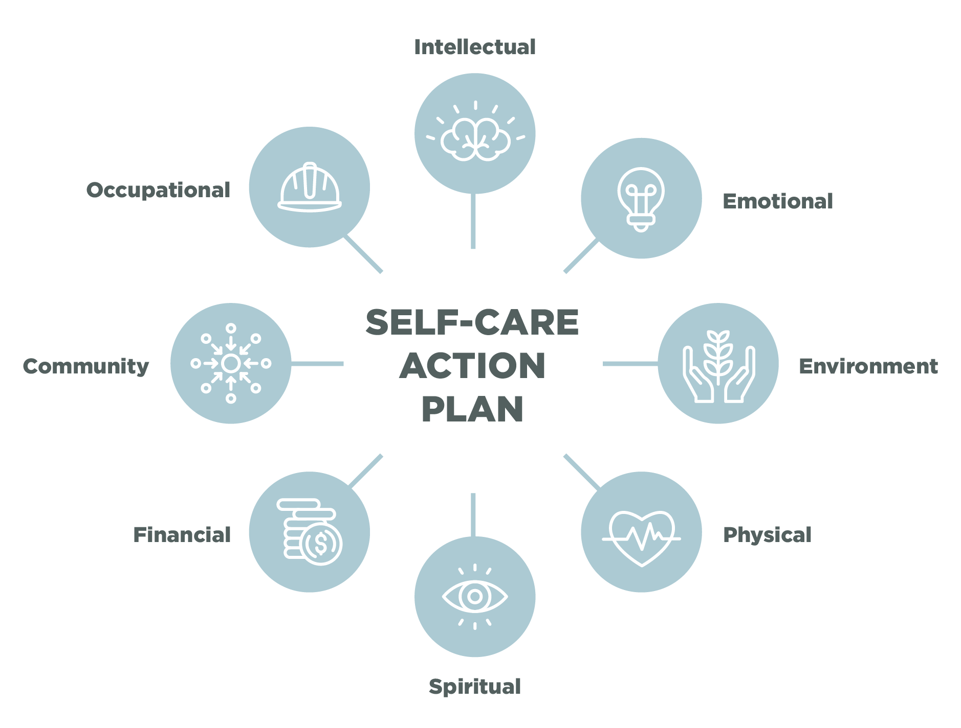
Developing a Self-care Action Plan
1. Recognize When You Need a Break
Identify early signs of stress—when you start to feel drained, take a moment to reset.
2. Set Healthy Boundaries
Limit overexposure to high-stress interactions.
Know when to involve other departments or escalate issues.
3. Reframe Interactions
See difficult interactions as a chance to practice empathy and patience.

Slide 26

Confidentiality and Self-care
Respect Privacy When Discussing Challenges
Avoid sharing specific resident details when venting or seeking advice.
Focus on emotions and strategies rather than personal details of others.
Who Can You Talk To?
Identify trusted individuals—managers, mentors—who can offer support while maintaining privacy.

Slide 27
Summary
Each interaction shapes the public’s view of municipal services.
Approach each resident with respect, empathy, and professionalism.
Listen actively, communicate clearly, and address issues at their root.
Understand residents’ perspectives and respond with compassion, even under stress.
Represent the city fairly, staying calm and respectful in all interactions.
Practicing self-care enables us to serve others effectively.
Take breaks, use support resources, and maintain confidentiality when discussing work challenges.

Slide 28

Questions?

